Slide 1
SAMSUNG INNOVATION CAMPUS — AI CAPSTONE PROJECT
BUILDING, TRAINING & COMPARING MACHINE LEARNING MODELS
FOR STUDENT DROPOUT PREDICTION FROM STRESS & ENGAGEMENT
Topic: Student Burnout & Dropout Risk Prediction — Proactive Academic Early Warning System
PRESENTED BY GROUP 03:
• Do Quang Minh (Team Leader) — Leakage-Free Pipeline, Domain Feature Engineering, Tree Ensembles & FastAPI Backend
• Vu Quang Huy (Team Member) — Statistical EDA, Multivariate KNN Imputation, Baseline/Neural Models & Web UI
2,000
25 → 34
4 Models
89.01%
Cleaned Student Profiles
Raw & Engineered Features
LR, RF, XGBoost, Soft Voting
Peak 5-Fold CV ROC-AUC

Slide 2
00 PRESENTATION AGENDA
Presentation Agenda & Executive Structure
A structured walkthrough from problem formulation and 6-step cleaning to 4-model benchmarking and live Web UI deployment
01. INTRODUCTION & BACKGROUND
02. DATASET & 6-STEP CLEANING
03. DOMAIN FEATURE ENGINEERING
• University student attrition & academic burnout dynamics.
• Research motivation & need for Proactive Early Warning.
• Group 03 role distribution & 4-phase milestone schedule.
• 800 raw records expanded to 2,000 clean student records.
• Imputing 18 incomplete columns via KNNImputer (k=7) + IQR.
• 100% clean standardized dataset (0 NaN values).
• 5-stage end-to-end Machine Learning execution workflow.
• Formulating 6 composite indices in DomainFeatureEngineer.
• Quantifying the Stress vs. Academic Engagement balance.
04. EXPLORATORY DATA ANALYSIS
05. 4-MODEL BENCHMARKING
06. WEB DASHBOARD & CONCLUSION
• Monotonic progression from Burnout to Dropout (up to 92%).
• Violin/Boxplot comparisons of 8 Stress & Engagement metrics.
• Pearson correlation matrix & socioeconomic stratification.
• Scenario 1 (Full Features) vs. Scenario 2 (Early Warning).
• Comparing LR, Random Forest, XGBoost & Soft Voting Ensemble.
• Peak CV ROC-AUC 89.01%, Test F1 83.63%, Test Acc 81.50%.
• 3-Tier System Architecture & FastAPI Web UI (app.py).
• Real-time dual predictions & prescriptive interventions.
• Key accomplishments, future roadmap (LSTM/SHAP) & Q&A.
SAMSUNG INNOVATION CAMPUS (SIC) — AI CAPSTONE PROJECT | GROUP 03: DO QUANG MINH • VU QUANG HUY
Slide 02 / 14

Slide 3
01 INTRODUCTION
Problem Statement & Conceptual Mechanism of Student Dropout
Student dropout is not an isolated event but the cumulative result of declining Academic Engagement and chronic Psychological Stress
1. DECLINING STUDY ENGAGEMENT
3. TARGET OUTCOME & AI SOLUTION
• Deteriorating class attendance (< 70%).
• Reduced daily self-study hours (Study_Hours_Per_Day).
• Eroding intrinsic academic motivation.
• Lower prior GPA & accumulating course Backlogs.
★ Target Variable: Dropout_Risk (Yes / No)
• Yes (At-Risk of Dropout): 54.6% of cohort
• No (Retained / Safe): 45.4% of cohort
★ Group 03 AI Solution:
• Dual-scenario Machine Learning architecture:
1. Full diagnostic prediction with Burnout_Level (89.01% ROC-AUC).
2. Early warning directly from raw Stress & Engagement (88.26% ROC-AUC).
• Interactive Web Dashboard for proactive advising.
MEDIATING STATE: ACADEMIC BURNOUT
★ Academic Burnout Syndrome (Burnout_Level):
• Triggered when chronic stress exceeds support buffers and motivation.
• Stratified into 3 distinct severity tiers:
- Low Burnout: 320 students (40.0%)
- Medium Burnout: 280 students (35.0%)
- High Burnout: 200 students (25.0%)
• Acts as the proximate mediator of student attrition.
2. CHRONIC PSYCHOLOGICAL STRESS
• Elevated academic Stress_Level & Anxiety_Score.
• Severe financial burden (Financial_Stress_Score).
• Peer comparison pressure (Peer_Pressure_Score).
• Sleep deprivation, screen fatigue & low family support.
SAMSUNG INNOVATION CAMPUS (SIC) — AI CAPSTONE PROJECT | GROUP 03: DO QUANG MINH • VU QUANG HUY
Slide 03 / 14

Slide 4
01 OBJECTIVES & TEAM
Project Objectives, Group 03 Role Assignment & Schedule
Balanced 50/50 technical workload distribution with 100% milestone completion across 4 project phases
4 CORE TECHNICAL OBJECTIVES
DO QUANG MINH — TEAM LEADER (50% SHARE)
• [Objective 1 - EDA & Scaling]: Clean 800 raw records via 6 steps and expand to 2,000 clean records (0 NaN).
• [Objective 2 - Feature Engineering]: Impute 18 incomplete columns via KNNImputer (k=7) and build 6 composite indices.
• [Objective 3 - 4-Model Benchmarking]: Train & cross-validate 4 flagship ML classifiers (LR, RF, XGBoost, Soft Voting) across 2 scenarios.
• [Objective 4 - Web Dashboard UI]: Deploy a real-time FastAPI Web App predicting both Burnout_Level and Dropout_Risk.
• Architected leakage-free ML Pipeline & DomainFeatureEngineer (6 composite indices).
• Trained Tree Ensembles & Boosting (Random Forest, Extra Trees, GB, XGBoost, Voting).
• Built FastAPI Backend service (app.py) and serialized production models (.pkl).
VU QUANG HUY — TEAM MEMBER (50% SHARE)
• Audited missing data (18/25 cols), performed statistical EDA & created 12 200-DPI figures.
• Trained Baseline, Kernel & Neural models (Logistic, SVM RBF, KNN, Decision Tree, MLP).
• Designed Frontend Dashboard UI and authored Final Report, WBS & Presentation Deck.
Phase 1 (Oct 19–20)
Phase 2 (Oct 21–25)
Phase 3 (Oct 26–29)
Phase 4 (Oct 30–Nov 05)
Initiation & Schema Audit
(Action Plan & WBS)
[✓ 100% Completed]
Statistical EDA, KNNImputer
& 6 Engineered Indices
[✓ 100% Completed]
5-Fold CV Benchmarking
10 Models × 2 Scenarios
[✓ 100% Completed]
FastAPI Web Dashboard
& Final SIC Deliverables
[✓ 100% Completed]
SAMSUNG INNOVATION CAMPUS (SIC) — AI CAPSTONE PROJECT | GROUP 03: DO QUANG MINH • VU QUANG HUY
Slide 04 / 14

Slide 5
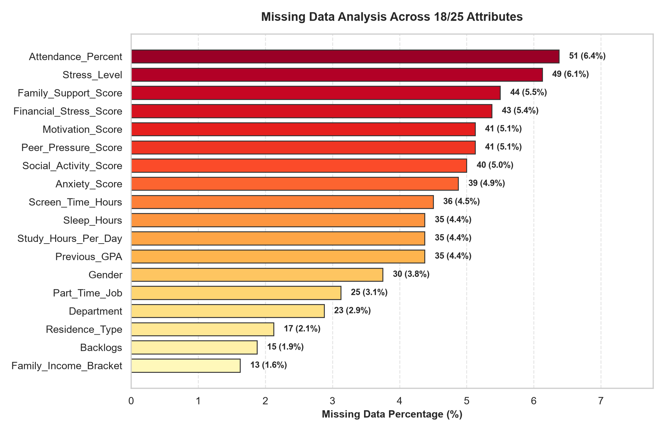
02 DATA & PREPROCESSING
Dataset Architecture (800 × 25) & Multivariate Missing Data Imputation
18/25 attributes contain missing values (1.6% – 6.4%), imputed via multivariate KNNImputer (k=7) inside the CV Pipeline
5 ATTRIBUTE DOMAINS & PREPROCESSING STRATEGY
• [1. Demographics - 7 cols]: Student_ID, Age (17–25), Gender, Year (1–4), Department (6 depts), Residence_Type, Family_Income_Bracket.
• [2. Study Engagement - 5 cols]: Attendance_Percent (30–100%), Study_Hours (0–8.1h), Previous_GPA, Backlogs (0–6), Motivation_Score.
• [3. Lifestyle - 5 cols]: Sleep_Hours, Screen_Time, Exercise_Freq, Social_Activity, Part_Time_Job.
• [4. Stress & Support - 6 cols]: Stress_Level, Anxiety_Score, Financial_Stress, Peer_Pressure, Family_Support, Counseling_Access.
• [5. Targets - 2 cols]: Burnout_Level (Low/Med/High) & Dropout_Risk (Yes: 437 | No: 363).
★ Why Multivariate KNNImputer (k=7)?
Listwise deletion loses >40% of rows; KNN preserves multi-feature correlations.
SAMSUNG INNOVATION CAMPUS (SIC) — AI CAPSTONE PROJECT | GROUP 03: DO QUANG MINH • VU QUANG HUY
Slide 05 / 14

Slide 6
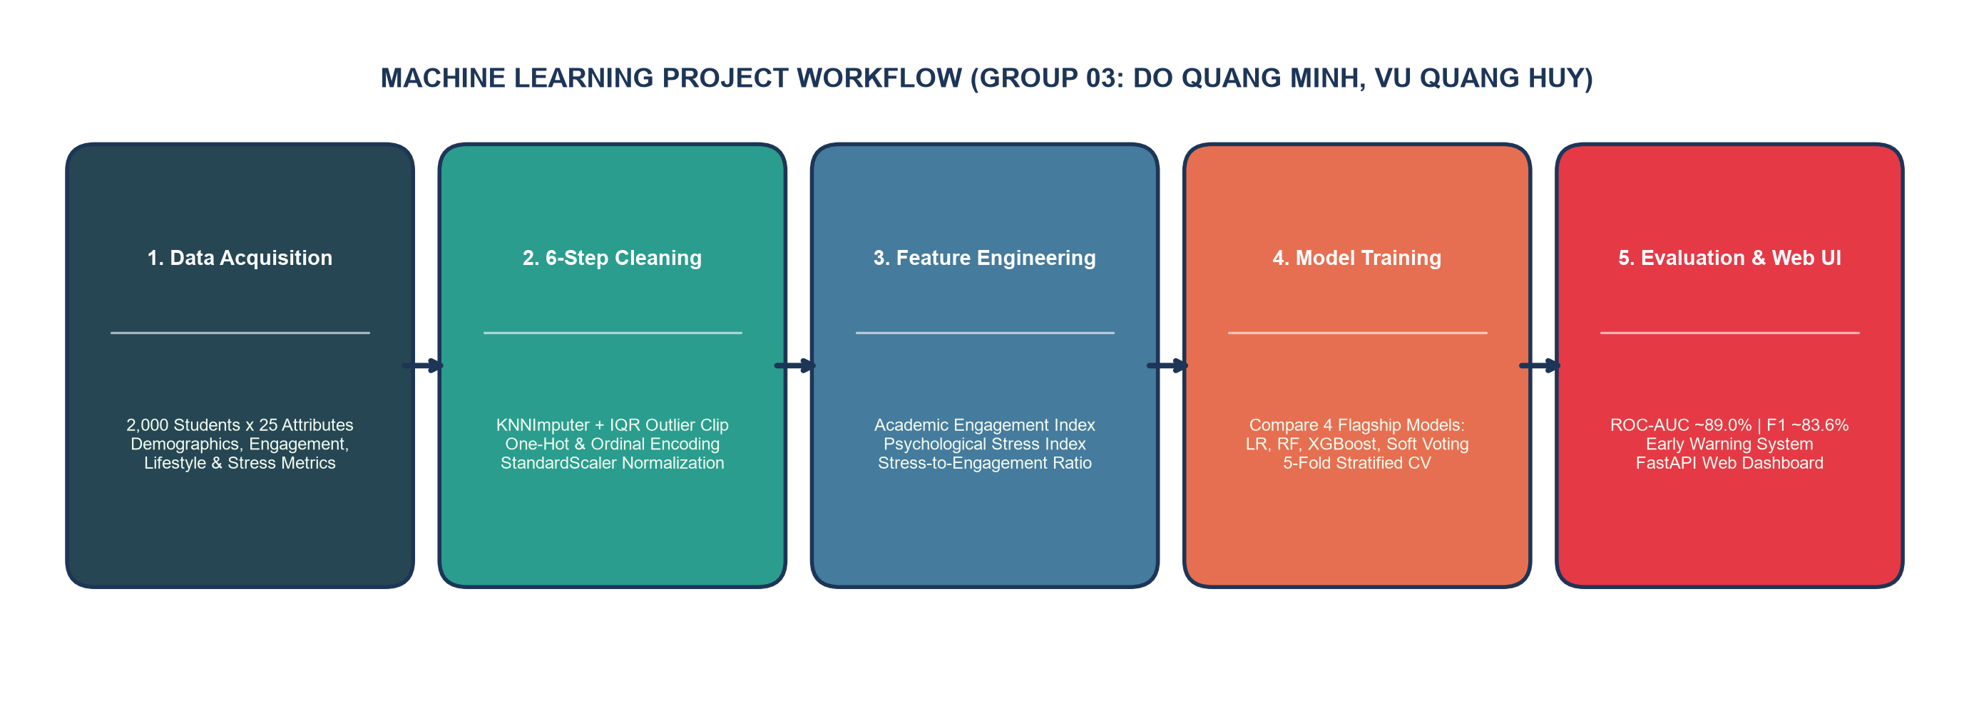
02 METHODOLOGY & FEATURES
5-Stage ML Workflow & Domain-Specific Feature Engineering
Custom DomainFeatureEngineer transformer quantifying the structural interplay between Stress and Study Engagement
1. Academic_Engagement_Index
2. Psychological_Stress_Index
3. Stress_Engagement_Ratio
0.35*(Attendance/10) + 0.25*Study
+ 0.25*Motivation + 0.15*GPA
0.35*Stress + 0.30*Anxiety
+ 0.20*Financial + 0.15*Peer
Psychological_Stress_Index /
(Academic_Engagement_Index + 1)
4. Net_Stress_Support_Balance
5. Digital_Fatigue_Ratio
6. Academic_Risk_Burden
Stress_Index - (0.5*Family
+ 0.3*Social + 0.2*Exercise)
Screen_Time_Hours /
(Sleep_Hours + 1.0)
1.5 * Backlogs +
(100 - Attendance) / 20.0
SAMSUNG INNOVATION CAMPUS (SIC) — AI CAPSTONE PROJECT | GROUP 03: DO QUANG MINH • VU QUANG HUY
Slide 06 / 14

Slide 7
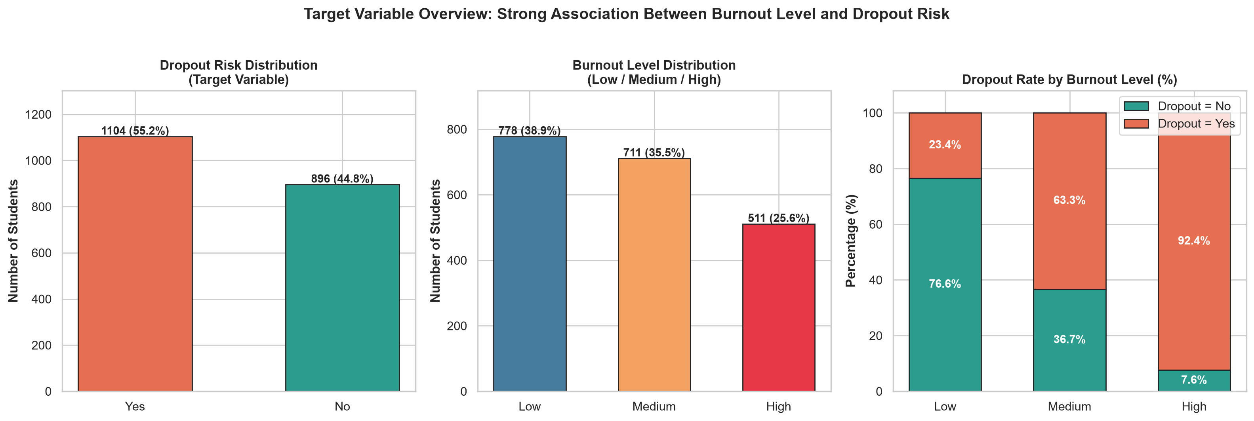
03 EDA INSIGHTS
EDA Insight 1: Burnout Level as the Primary Driver of Dropout Risk
Student dropout rate surges nearly 4-fold from Low Burnout (23.8%) to High Burnout (92.0%, Pearson r = +0.550)
LOW BURNOUT (n=320)
MEDIUM BURNOUT (n=280)
HIGH BURNOUT (n=200)
23.8% Dropout
63.2% Dropout
92.0% Dropout
244 Retained vs. 76 Dropped Out
Healthy study-life equilibrium
103 Retained vs. 177 Dropped Out
Critical transition zone for early advising
Only 16 Retained vs. 184 Dropped Out!
Severe attrition risk requiring urgent action
SAMSUNG INNOVATION CAMPUS (SIC) — AI CAPSTONE PROJECT | GROUP 03: DO QUANG MINH • VU QUANG HUY
Slide 07 / 14

Slide 8
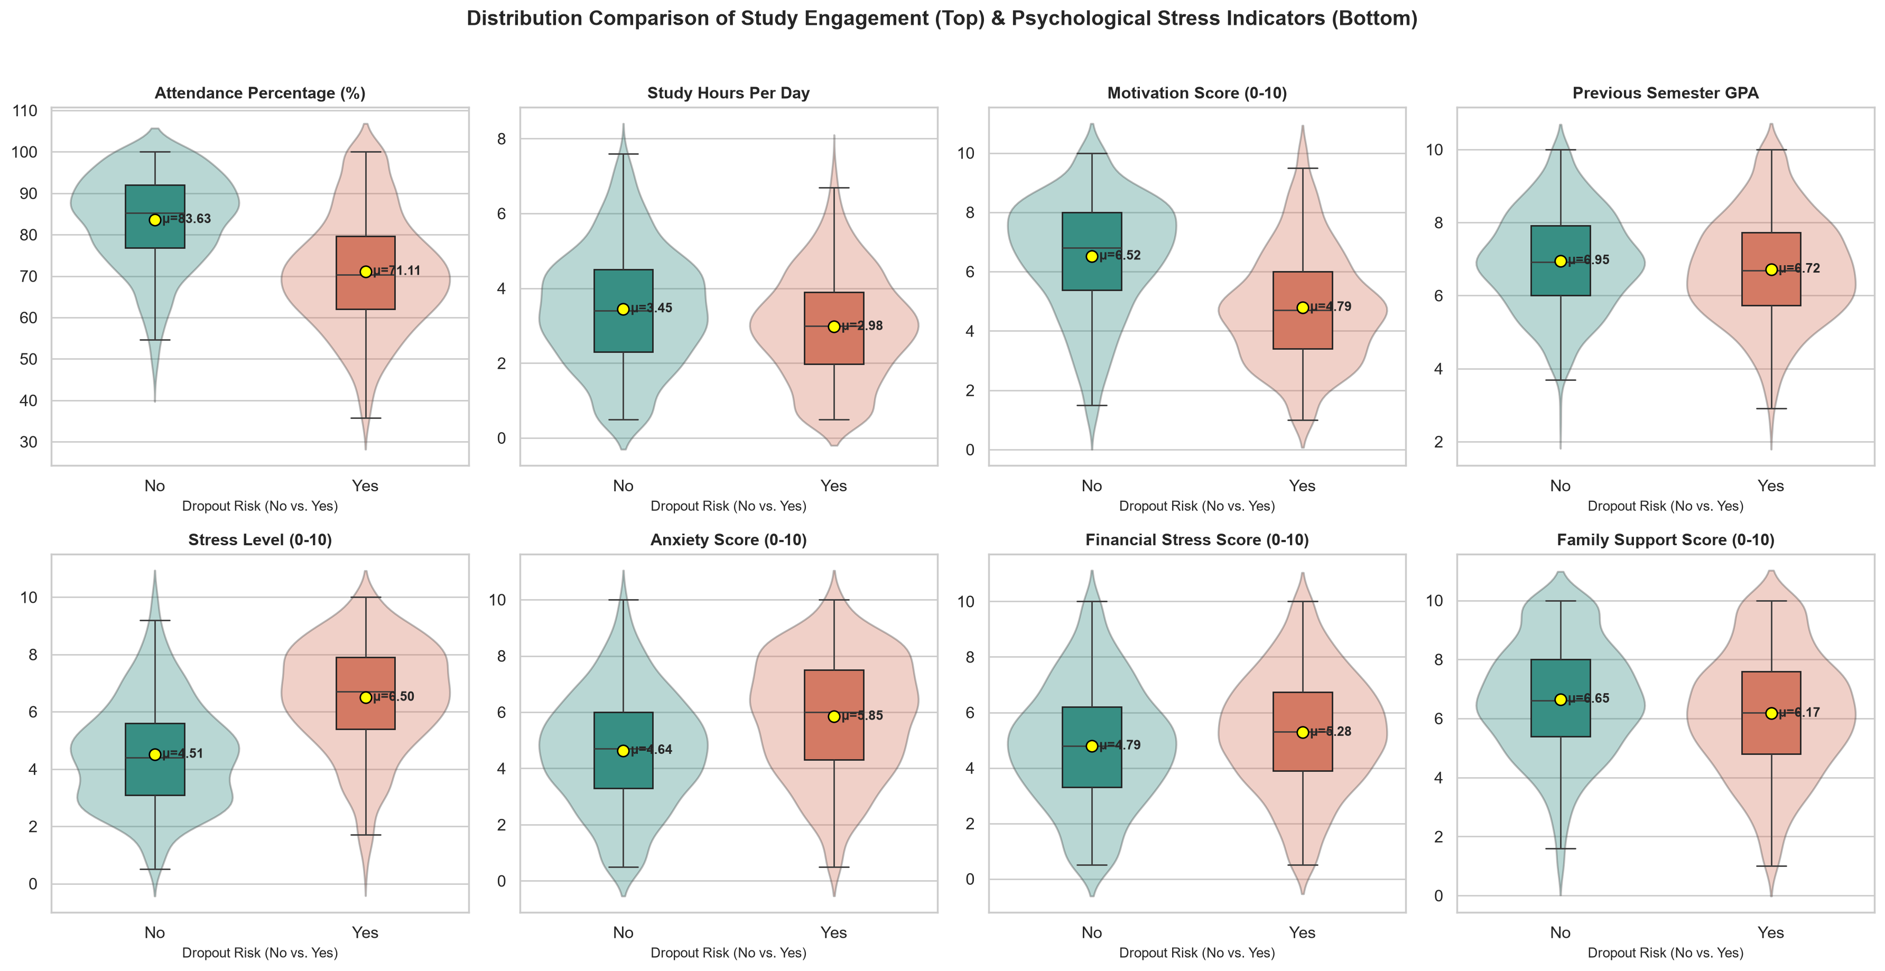
03 EDA INSIGHTS
EDA Insight 2: Study Engagement vs. Psychological Stress Distributions
Dropout students (Yes) show a 7% attendance deficit (73.7% vs 80.7%), fewer study hours, lower motivation, and elevated stress/anxiety
MEAN COMPARISON (No vs Yes)
★ Academic Engagement:
• Attendance_Percent:
No: 80.68% | Yes: 73.70%
• Study_Hours_Per_Day:
No: 3.43h | Yes: 2.93h
• Motivation_Score:
No: 5.90 | Yes: 5.11
• Previous_GPA:
No: 7.02 | Yes: 6.72
★ Psychological Stress:
• Stress_Level:
No: 5.17 | Yes: 5.81
• Anxiety_Score:
No: 4.65 | Yes: 5.26
• Financial_Stress:
No: 4.75 | Yes: 5.26
• Family_Support:
No: 6.73 | Yes: 6.16
SAMSUNG INNOVATION CAMPUS (SIC) — AI CAPSTONE PROJECT | GROUP 03: DO QUANG MINH • VU QUANG HUY
Slide 08 / 14

Slide 9
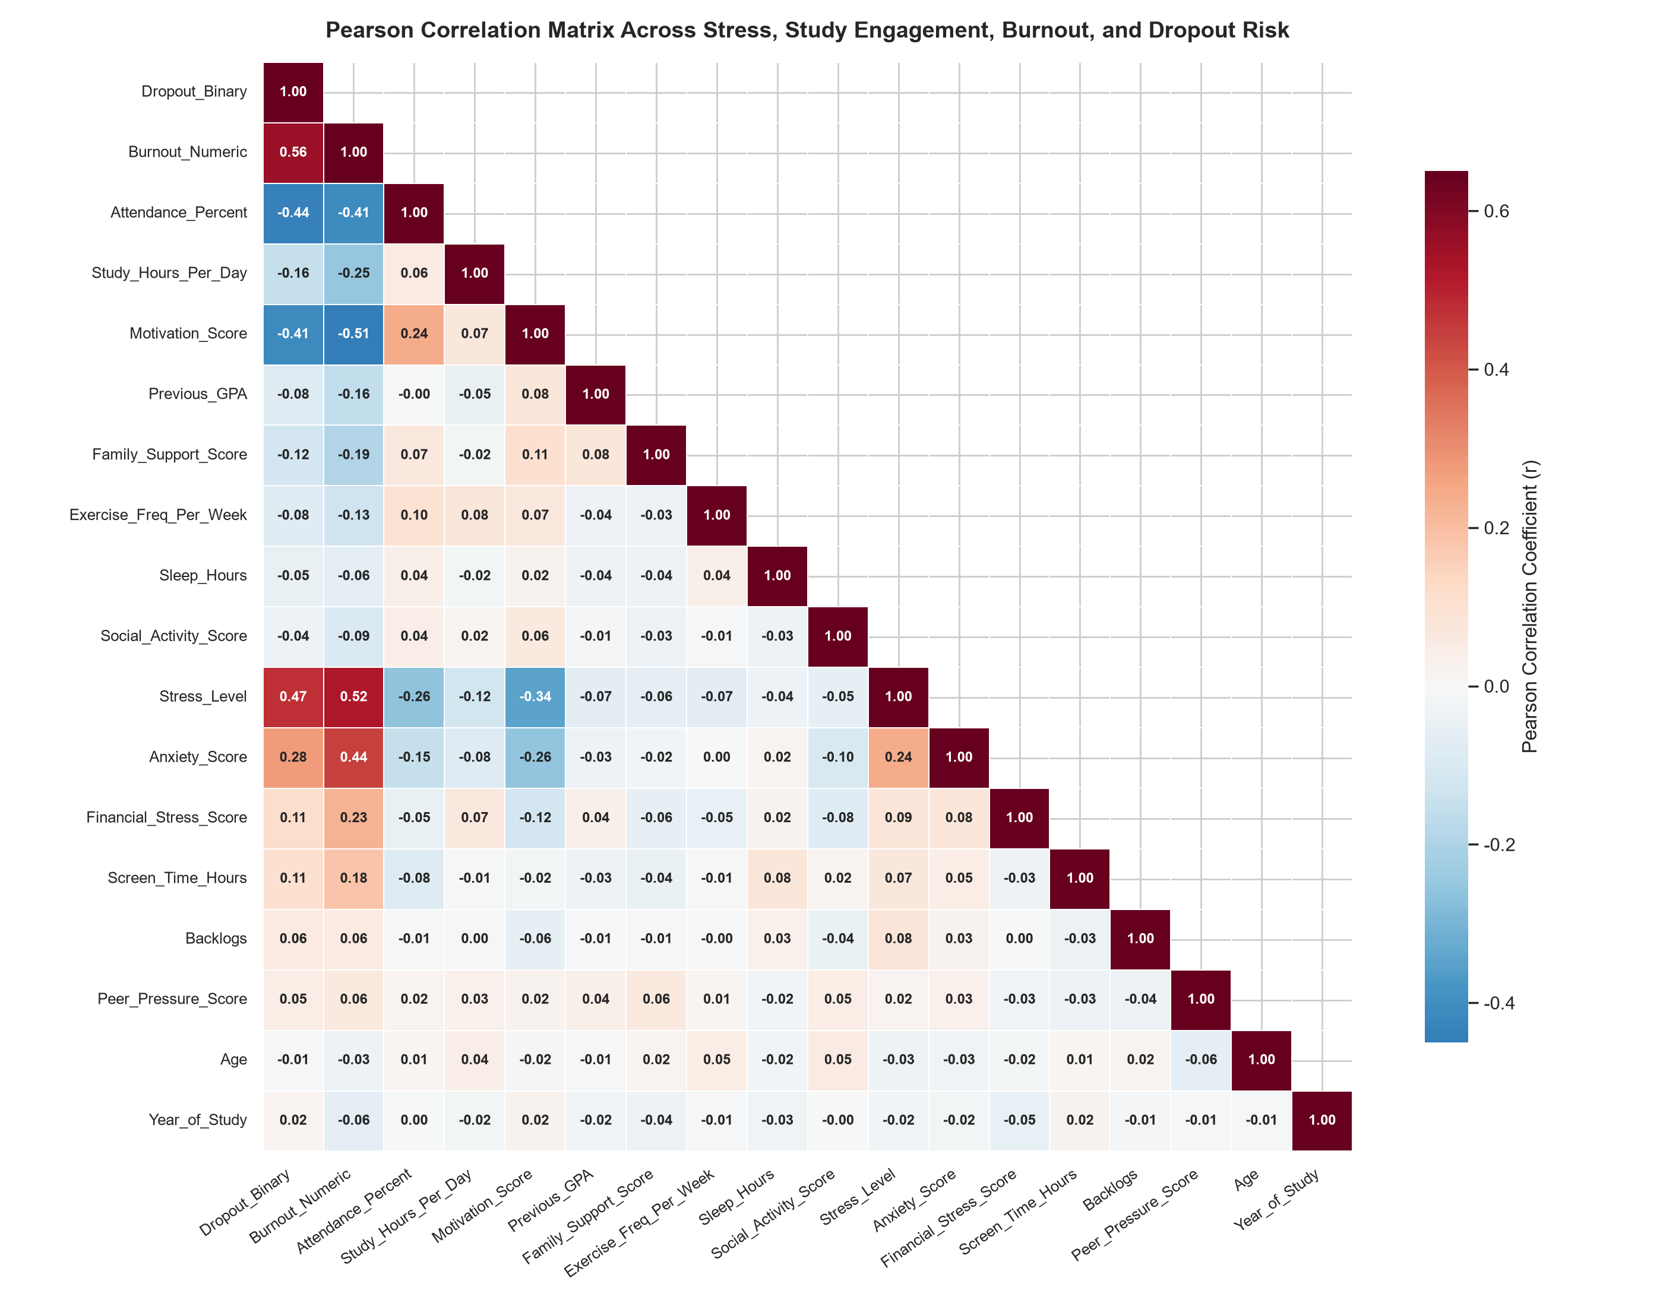
03 EDA INSIGHTS
EDA Insight 3: Pearson Correlation Matrix & Socioeconomic Factors
Identifying top 5 protective factors (negative correlation) and top 5 risk factors (positive correlation) driving student attrition
PROTECTIVE FACTORS (NEGATIVE CORRELATION)
• 1. Attendance_Percent: r = -0.244 (Dropout) | -0.325 (Burnout)
• 2. Motivation_Score: r = -0.193 (Dropout) | -0.249 (Burnout)
• 3. Study_Hours_Per_Day: r = -0.160 (Dropout) | -0.257 (Burnout)
• 4. Family_Support_Score: r = -0.137 (Dropout) | -0.205 (Burnout)
• 5. Previous_GPA & Exercise: r = -0.106 (Academic resilience)
RISK FACTORS (POSITIVE CORRELATION)
• 1. Burnout_Numeric: r = +0.550 (Strongest proximate predictor)
• 2. Stress_Level: r = +0.164 (Dropout) | +0.270 (Burnout)
• 3. Anxiety_Score: r = +0.145 (Dropout) | +0.247 (Burnout)
• 4. Screen_Time_Hours: r = +0.127 (Dropout) | +0.212 (Burnout)
• 5. Financial_Stress & Low Income: 62.1% dropout in Low-Income tier
SAMSUNG INNOVATION CAMPUS (SIC) — AI CAPSTONE PROJECT | GROUP 03: DO QUANG MINH • VU QUANG HUY
Slide 09 / 14

Slide 10
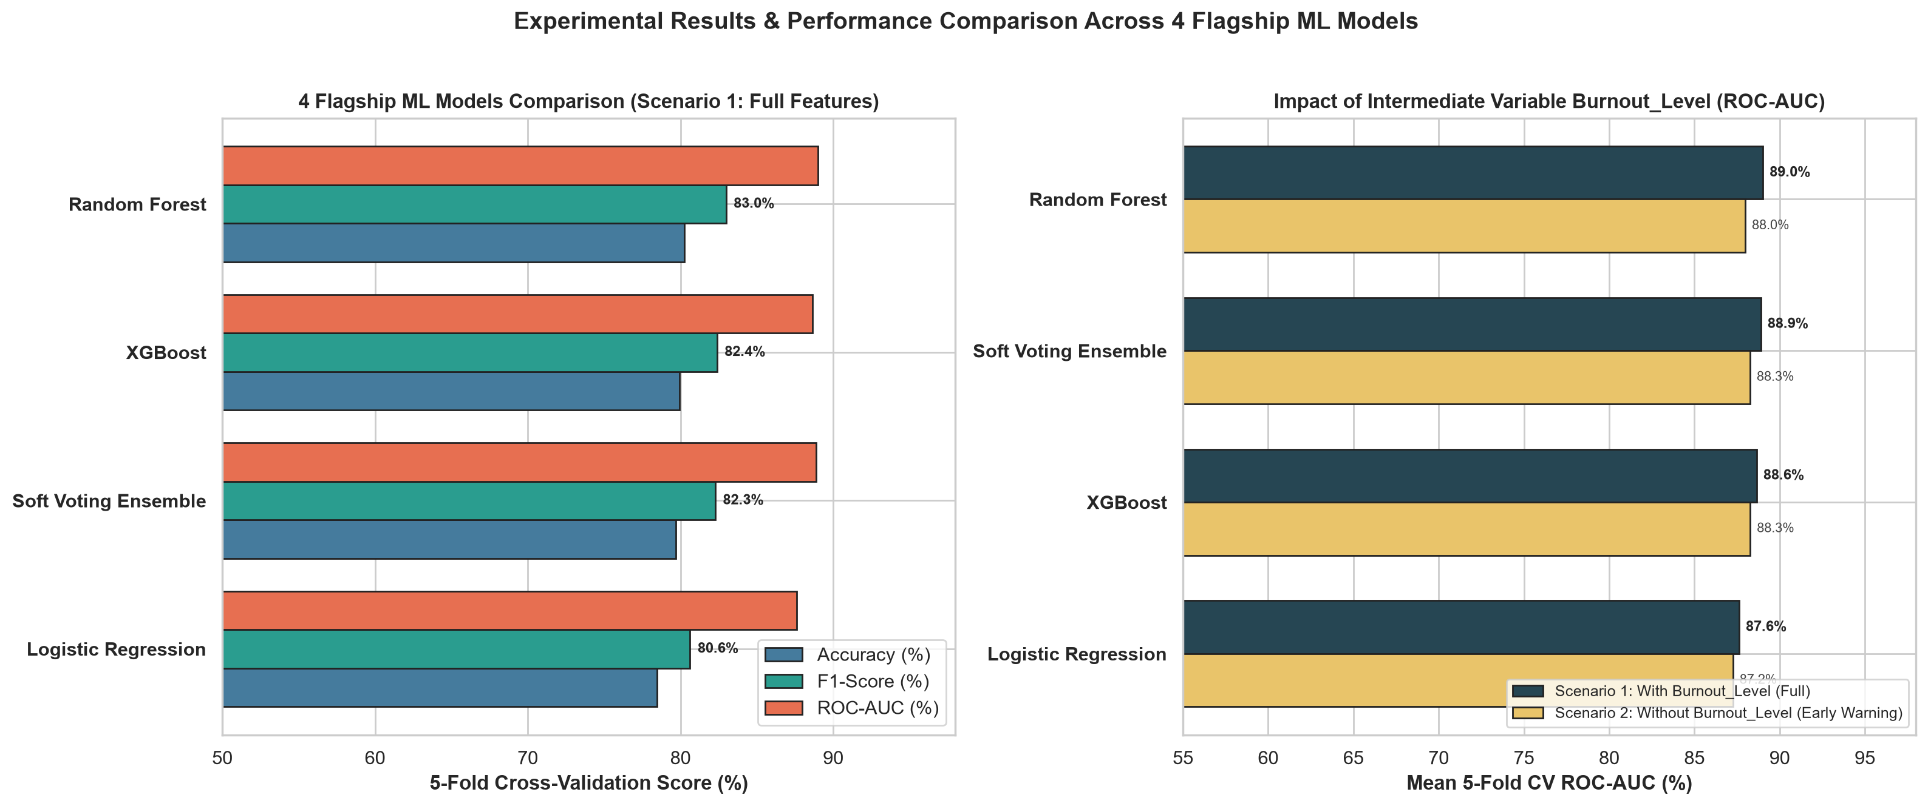
04 MODEL BENCHMARKING
Benchmarking 4 Flagship Machine Learning Models Across 2 Scenarios
Rigorous 5-Fold Stratified CV (n=2,000): Random Forest leads Scenario 1; XGBoost & Soft Voting lead Scenario 2
SCENARIO 1: FULL FEATURES (WITH BURNOUT_LEVEL)
SCENARIO 2: EARLY WARNING (WITHOUT BURNOUT_LEVEL)
• Random Forest achieves peak: CV ROC-AUC 89.01%, Test Acc 81.50%, Test F1 83.63%.
• Soft Voting Ensemble (LR+RF+XGB) follows with CV ROC-AUC 88.89%, Test Acc 80.25%.
• XGBoost leads 5-Fold CV: Acc 79.95%, F1 82.40%, ROC-AUC 88.26%.
• Soft Voting Ensemble achieves 88.25% CV ROC-AUC and 87.39% Test ROC-AUC.
SAMSUNG INNOVATION CAMPUS (SIC) — AI CAPSTONE PROJECT | GROUP 03: DO QUANG MINH • VU QUANG HUY
Slide 10 / 14

Slide 11
04 QUANTITATIVE METRICS
Comprehensive Experimental Evaluation Matrix Across 4 Flagship Models
Generalization gap between 5-Fold CV and 20% Hold-Out Test (n=400) remains minimal, confirming strong regularization
Rank & ML Classifier | S1: CV Acc | S1: CV Recall | S1: CV F1 | S1: CV AUC | S1: Test Acc | S1: Test F1 | S1: Test AUC | S2: Early CV AUC
1. Random Forest ★ | 80.25% | 86.38% | 82.98% | 89.01% | 81.50% | 83.63% | 88.42% | 87.97%
2. Soft Voting Ensemble ★ | 79.70% | 84.74% | 82.27% | 88.89% | 80.25% | 82.17% | 88.32% | 88.25%
3. XGBoost ★ | 79.95% | 84.56% | 82.39% | 88.64% | 78.50% | 80.28% | 87.99% | 88.26%
4. Logistic Regression | 78.45% | 81.64% | 80.62% | 87.61% | 78.25% | 80.18% | 87.60% | 87.25%
SAMSUNG INNOVATION CAMPUS (SIC) — AI CAPSTONE PROJECT | GROUP 03: DO QUANG MINH • VU QUANG HUY
Slide 11 / 14

Slide 12
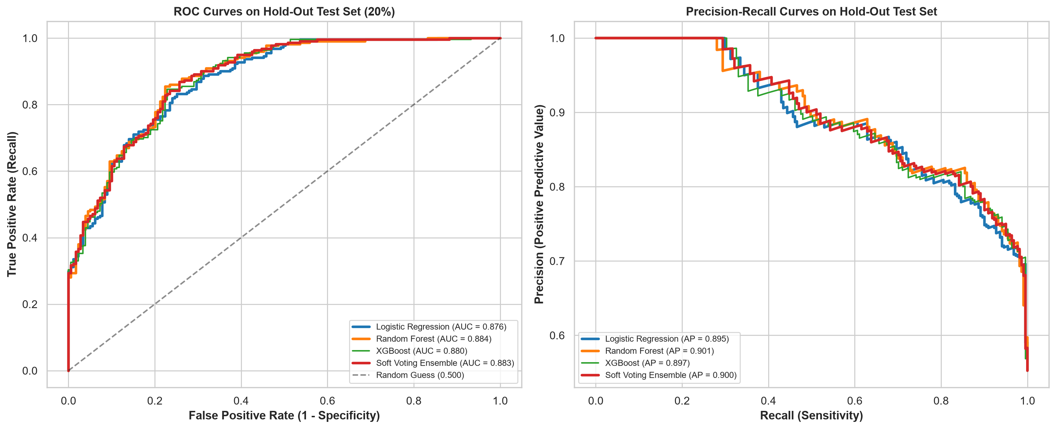
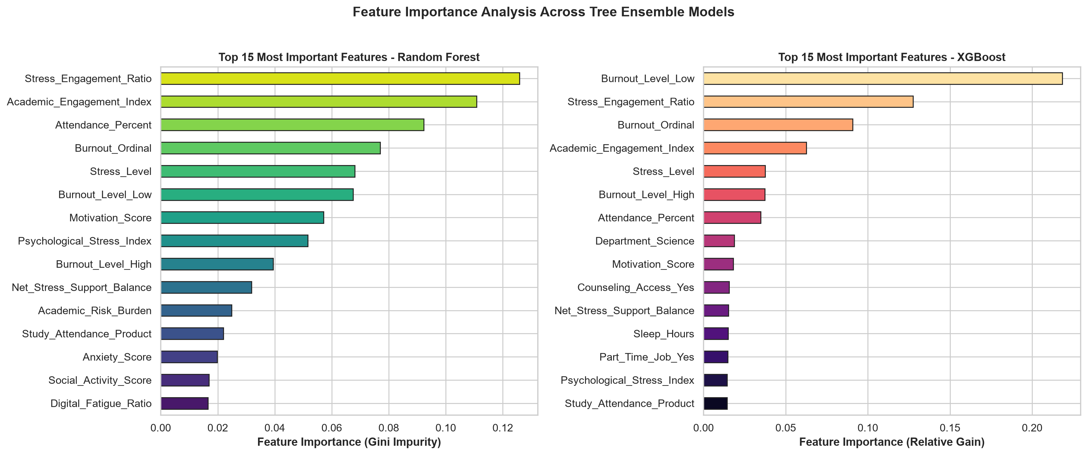
04 MODEL EXPLAINABILITY
ROC / Precision-Recall Curves & Feature Importance Analysis
Engineered indices (Stress_Engagement_Ratio & Academic_Engagement_Index) rank immediately behind Burnout_Ordinal
KEY INSIGHTS FROM ROC/PR CURVES & FEATURE IMPORTANCE
• Top 6 Predictors of Student Dropout: (1) Burnout_Ordinal, (2) Stress_Engagement_Ratio, (3) Academic_Engagement_Index, (4) Psychological_Stress_Index, (5) Attendance_Percent, (6) Net_Stress_Support_Balance.
• High Recall (80.3% – 83.9%): Captures over 4 out of 5 truly at-risk students, minimizing costly false-negative omissions in university advising.
SAMSUNG INNOVATION CAMPUS (SIC) — AI CAPSTONE PROJECT | GROUP 03: DO QUANG MINH • VU QUANG HUY
Slide 12 / 14

Slide 13
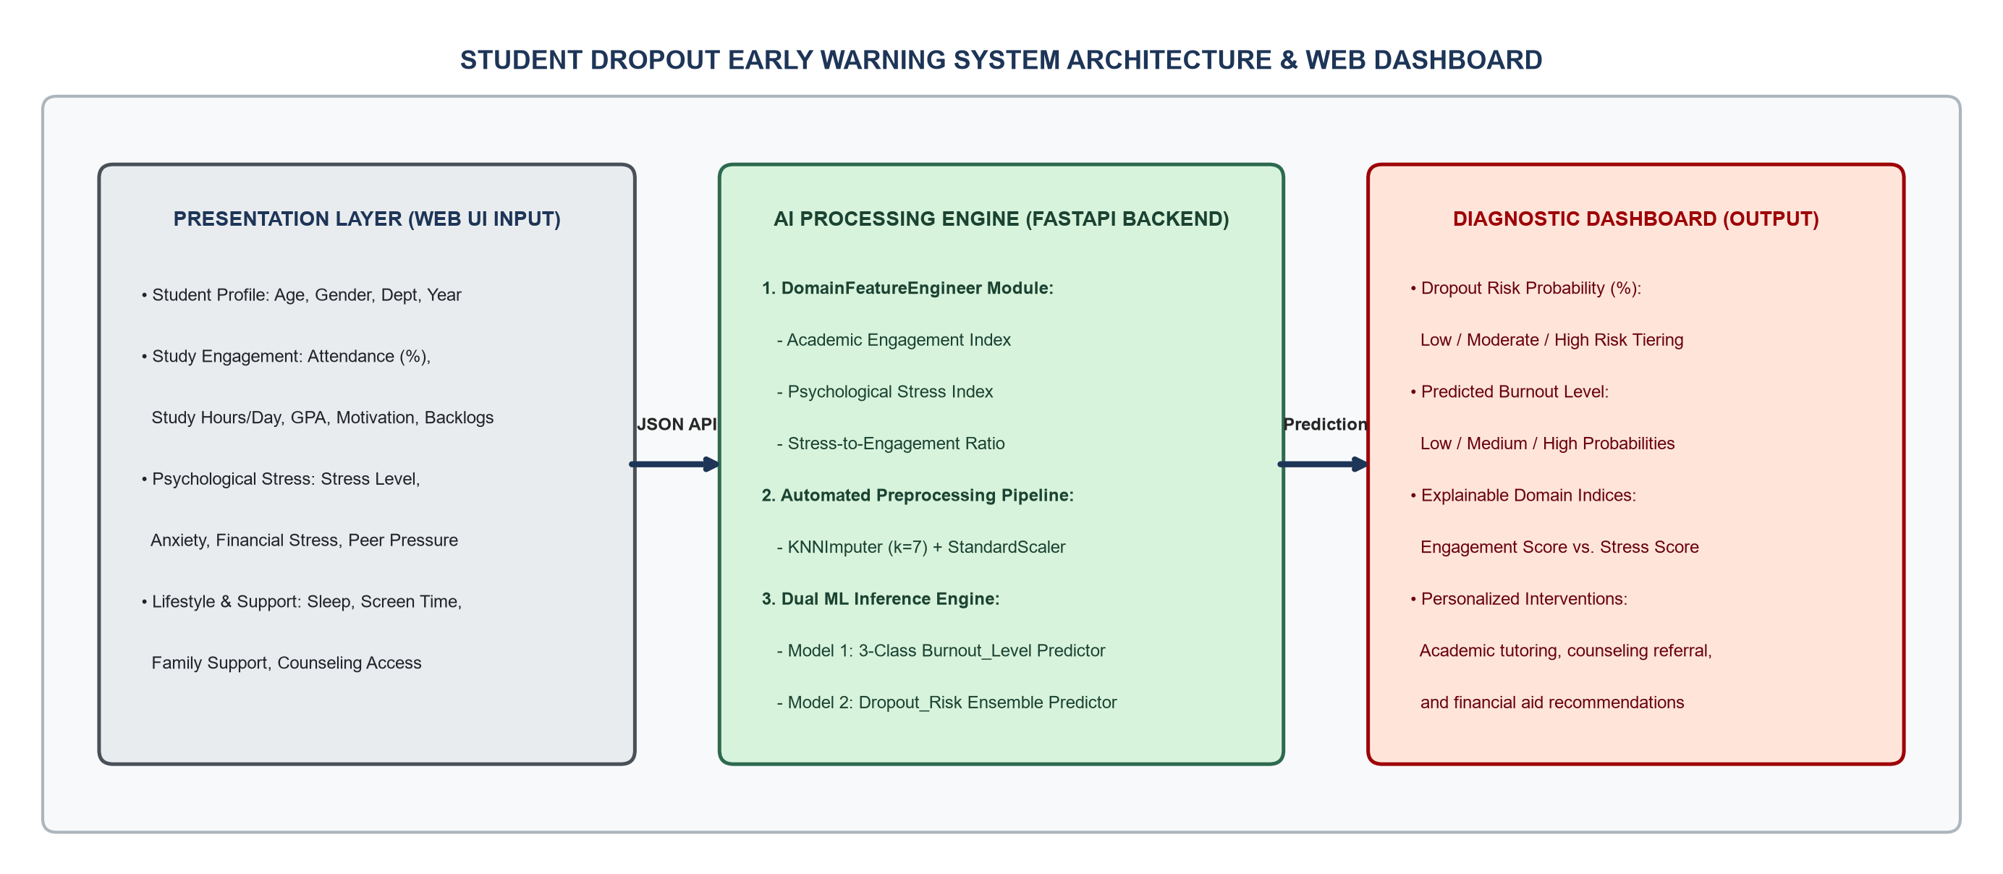
05 WEB APPLICATION
3-Tier System Architecture & Interactive FastAPI Web Dashboard
FastAPI Web App (app.py) with 18 interactive sliders and 3 student presets delivering dual AI diagnostics in < 30ms
WEB DASHBOARD CAPABILITIES
★ 1. Three One-Click Student Presets:
• [Safe Tier] Engaged Student: 8.0% Risk
• [Warning Tier] Moderate Stress: ~58% Risk
• [Critical Tier] High Burnout: 95.8% Risk!
★ 2. Real-Time Dual AI Inference:
• 3-Class Burnout_Level probabilities.
• Calibrated Dropout_Risk probability (%).
★ 3. Explainable Indices & Actions:
• Displays Engagement vs. Stress scores.
• Generates targeted tutoring, counseling & financial aid referrals.
SAMSUNG INNOVATION CAMPUS (SIC) — AI CAPSTONE PROJECT | GROUP 03: DO QUANG MINH • VU QUANG HUY
Slide 13 / 14

Slide 14
06 CONCLUSION & Q&A
Conclusions, Future Research Roadmap & Q&A
Successfully achieved all capstone objectives — Ready for integration with institutional Learning Management Systems (LMS)
KEY PROJECT ACCOMPLISHMENTS
FUTURE RESEARCH & DEPLOYMENT ROADMAP
• [1. 6-Step Cleaning & Scaling]: Expanded 800 raw records to 2,000 100% clean profiles; quantified dropout surge across Burnout tiers (23.8% → 63.2% → 92.0%).
• [2. Domain Engineering]: Formulated 6 composite indices capturing the balance between Psychological Stress and Engagement.
• [3. 4-Model Benchmarking]: Achieved 89.01% CV ROC-AUC, 83.63% Test F1-Score, and 81.50% Test Accuracy with Random Forest & Voting.
• [4. Practical Software]: Delivered a real-time FastAPI Early Warning Dashboard for university advisors.
• [Direction 1 - Longitudinal Time-Series]: Track weekly attendance and stress logs using sequential LSTM / Transformer models.
• [Direction 2 - Local Explainability (SHAP)]: Embed per-student SHAP waterfall plots directly inside the Web Dashboard.
• [Direction 3 - LMS API Integration]: Connect with Moodle / Canvas APIs for automated monthly cohort screening.
• [Direction 4 - Multi-Campus Scaling]: Expand dataset to 5,000–10,000 students across Vietnamese universities.
THANK YOU FOR YOUR ATTENTION! — QUESTIONS & DISCUSSION (Q&A)
Group 03: Do Quang Minh (Team Leader) • Vu Quang Huy (Team Member) | Live Web Demo: http://127.0.0.1:8000
SAMSUNG INNOVATION CAMPUS (SIC) — AI CAPSTONE PROJECT | GROUP 03: DO QUANG MINH • VU QUANG HUY
Slide 14 / 14

